Slide 1
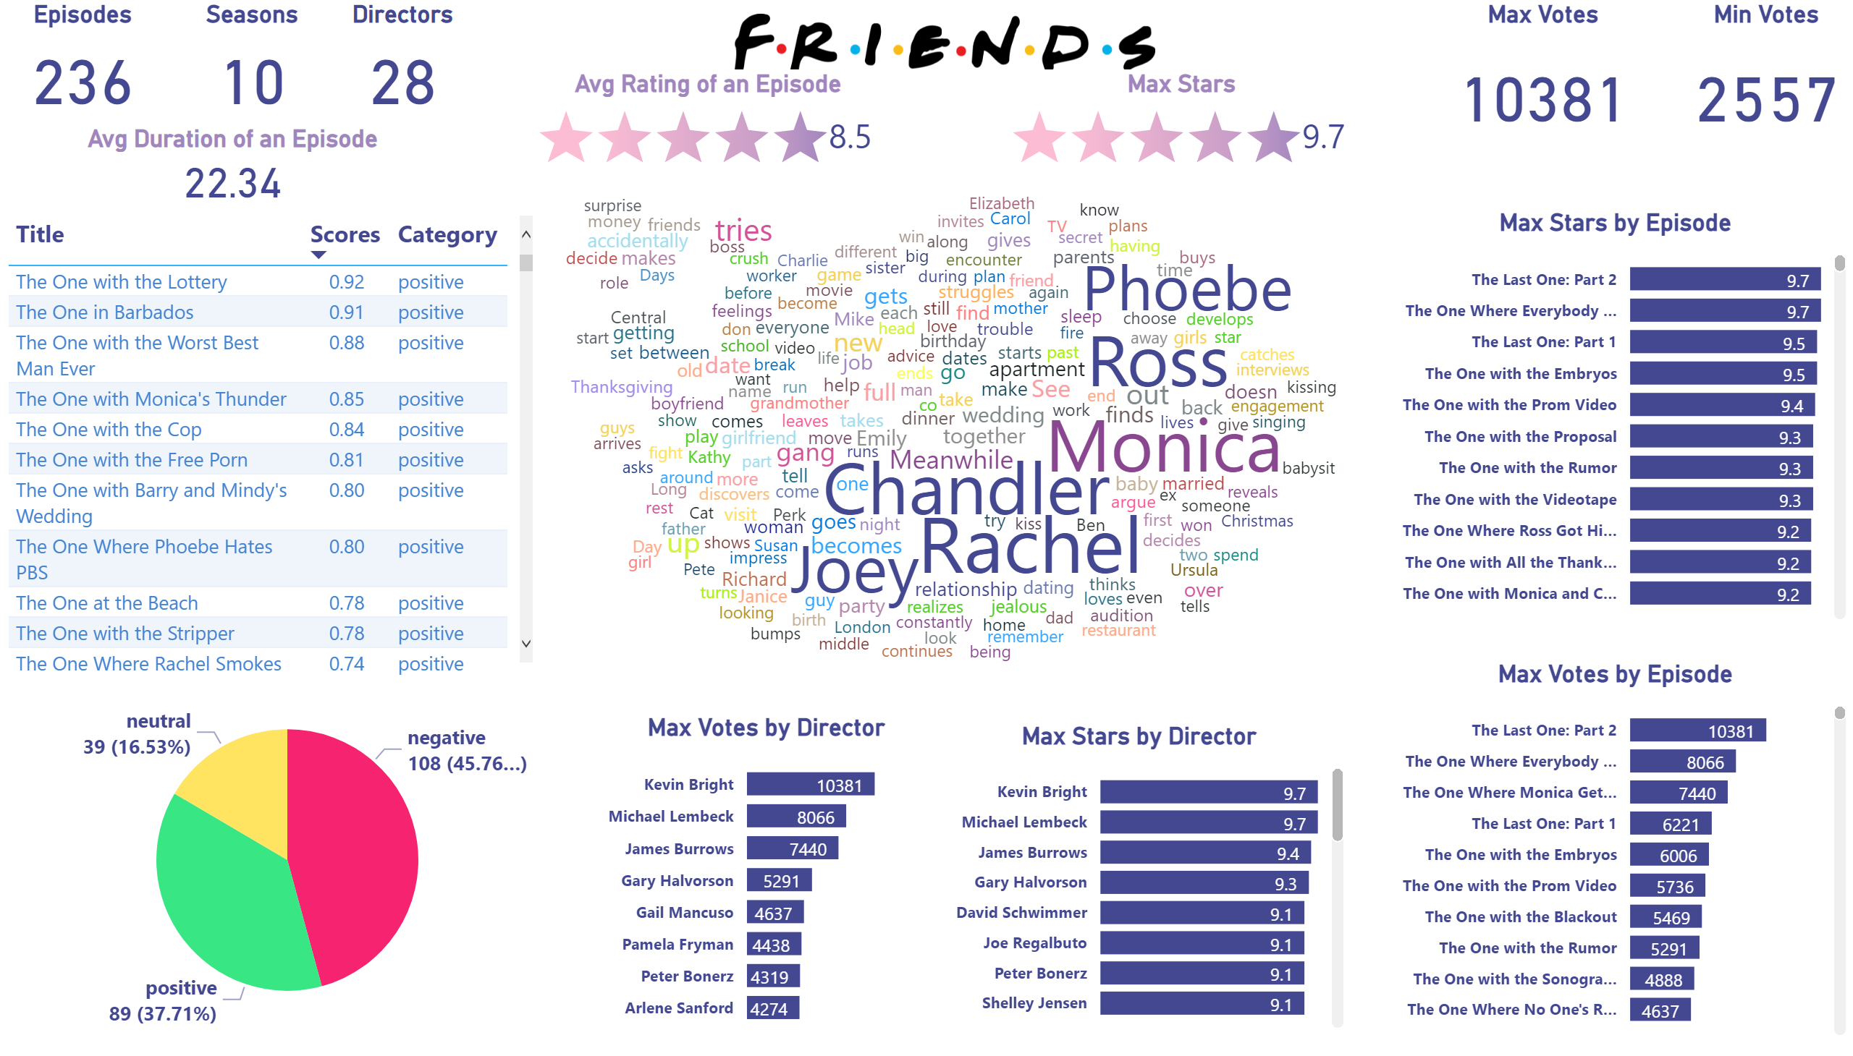
Friends
Notes:
WordCloud1447959067750
No alt text provided
Summary
No alt text provided
tableEx
No alt text provided
barChart
No alt text provided
barChart
No alt text provided
Max Votes by Episode
No alt text provided
Max Stars by Episode
No alt text provided
image
No alt text provided
Episodes
No alt text provided
Seasons
No alt text provided
PBI_CV_9053509D_D461_463A_B485_CE9F6AB0F13D
No alt text provided
Directors
No alt text provided
Avg Duration of an Episode
No alt text provided
Max Votes
No alt text provided
Min Votes
No alt text provided
PBI_CV_9053509D_D461_463A_B485_CE9F6AB0F13D
No alt text provided

Slide 2


